Slide 1
Charger Utilisation & Efficiency Analysis
Measuring usage, idle time, and bottlenecks to optimise infrastructure and reduce congestion

Slide 2
Approach and a Data Quality Catch
How utilisation was measured
Utilisation = time a charger is in use / time it was available.
Available time runs from 1 January of the station’s activation year to the end of 2024. The installation_date field was not used as it conflicts with session activity.
Overlapping sessions on a charger were merged into continuous busy periods, so no time is counted twice.
33 stations, 199 chargers (95 * 50kW, 69 * 150kW, 35 * 300kW), 294,024 sessions.
8.3%
Of sessions start before an earlier session on the same charger has finished
3,808
Sessions starts at the exact same moment as another on the same charger
5.2%
Overstatement of busy time if session durations were simply added up
99.8%
Of overlapping sessions had another charger free at the same station

Slide 3
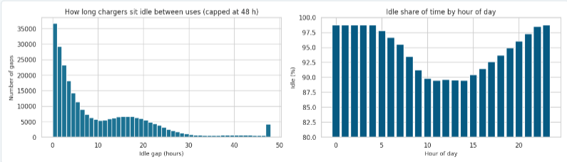
Chargers Sit Idle 95% of the Time
5.4%
Network utilisation
22.7 of 24 h
Average idle time per charger per day
6.1 h
Median wait between two uses
8.2 days
Longest single idle spell

Slide 4
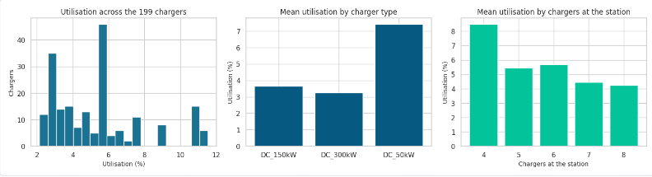
Station Size and Charger Type Drive Utilisation
Every station gets about 13.9 session a day whatever its size, so utilisation falls from 8.5% (4 chargers) to 4.2% (8 chargers).
50kW chargers average 7.4% against 3.2% for 300kW: all types get the same sessions per day, but slower chargers are occupied longer per session.
Station size and charger type together explain 99.7% of the differences between chargers.

Slide 5
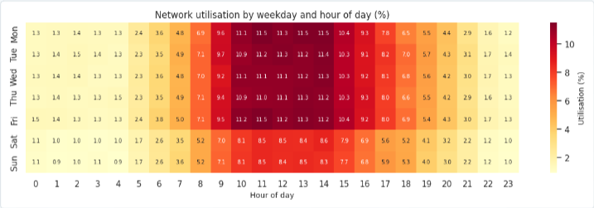
When Chargers Are Used: Network Heatmap
Use is concentrated between about 09:00 and 15:00; the busiest hour is Monday at 11:00 (11.5%).
Weekday midday averages 11.2% utilisation, weekend midday 8.4%, and overnight 1.2%.
Even at the busiest hour, chargers are idle close to 90% of the time.

Slide 6
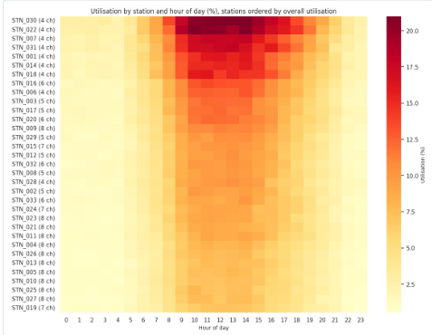
When Chargers Are Used: Station Heatmap
Every station has the same daily shape: a midday plateaus and a quiet night.
The brightest rows are mostly the 4-charger stations, fading towards the 8-charger stations at the bottom.
STN_030 (London, 4-chargers) is the busiest: weekday midday cells reach 20-28%, with a 10:00-14:59 average of about 21%.
Heatmaps for all 199 chargers, and for any single station, are saved with the notebook outputs.

Slide 7
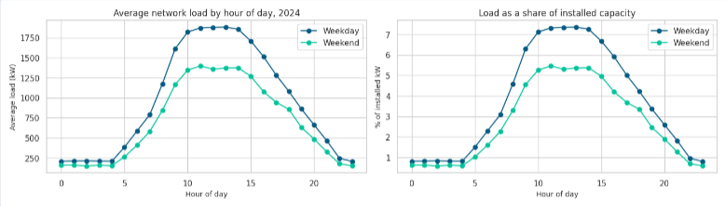
Peak Load Is a Small Share of Installed Power
882kW
Average load in 2024 (3.4% of 25,600kW installed)
1,882kW
Weekday peaks at 13:00 (7.4% of installed)
2,796kW
Highest single hour of 2024 (10.9% of installed)
40.7%
Of daily energy delivered 10:00-14:59 vs 23.6% in the 16:00-20:59 peak-price window

Slide 8
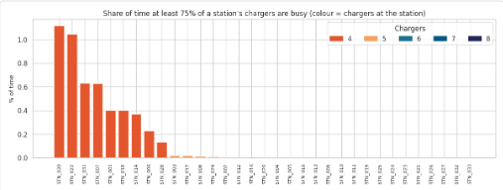
Bottlenecks: Only the Smallest Stations Get Close
Only 14 of 33 stations ever have every charger busy at once; the highest share of time is 0.061% (about 5 hours a year).
The nine most congested stations are exactly the nine 4-charger stations.
STN_030 and STN_022 (both London) are at least 75% busy for about 1.1% of the time.

Slide 9
Ranking: Real for Groups, Noise for Individual Chargers
Ranked by | Highest group | Lowest group
Utilisation | 50kW at 4-charger stations: 11.0% | 300kW at 8-charger stations: 2.3%
Revenue per charger per day | 300kW at 4-charger stations: £153 | 50kW at 8-charger stations: £34
99.7%
Of utilisation differences explained by charger type and station size
-0.09
Correlation of rankings between odd and even months, once peers of the same type and size are compared
10.9-11.5%
The top chargers (all 50kW at 4-charger stations) earn £67-73 a day, less that the bottom 10 (£172-80)

Slide 10
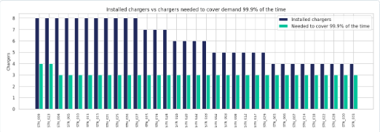
Capacity Installed vs Needed
199
Chargers installed
101
Needed to cover demand 99.9% of the time
70
Needed for 99% of the time
127
Needed for 99.9% of the time
Almost every station needs just 3 chargers at the 99.9% standard; only STN_009 and STN_023 (Scotland) need 4.
The surplus sits mainly in the 11 8-charger stations.

Slide 11
Recommendations
Do not add chargers now
Utilisation is 5.4%, no station is fully occupied for more than 0.061% of the time, and peak load is 7.4% of installed power.
Watch the nine 4-charger stations first
They are the only ones near congestion and the first candidates for expansion if demand per station grows.
Right-size the 8-charger stations
Most need about 3 chargers at the 99.9% standard. Plan 4-5 per new site. The surplus (72-129 chargers) is indicative only.
Review 300 kW units before buying more
17.6% of chargers but 41% of installed power, delivering 33% of the energy. Capital-cost data is needed to decide.
Pilot peak-price changes and fix allocation
The peak-price window covers 23.6% of energy against 40.7% at the midday peak. In 99.8% of double-bookings a free charger was available.

